Slide 1
Lexical Analyzer
700741258 Jisoo Ahn
700661193 Austin Leavitt
Notes:
You can add your name this page.

Slide 2
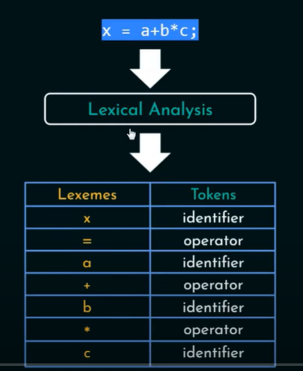
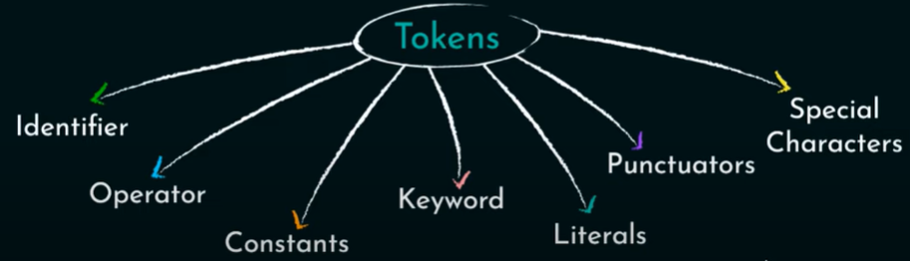
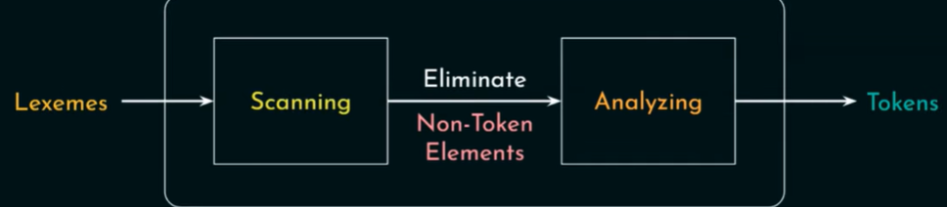
Lexical Analyzer
<How to operate>
<Types of tokens>
<Process of lexical analyzer>
-> create token stream
-> input: lexeme, output: token
Notes:
It’s about simple explain of lexical analyzer. If you think this page isn’t necessary, you can remove.

Slide 3
Work summary
Adding and recognizing supported operators and special characters
Operators consisting of multiple characters such as ‘>=’ or ‘!=‘ required special logic in the lookup() function
Reserved words
New function reservedLookup()
Any string not reserved is treated as an identifier
Unsupported terminals return -1 (syntax error) and terminate
Notes:
Can you fill this page about code?

Slide 4
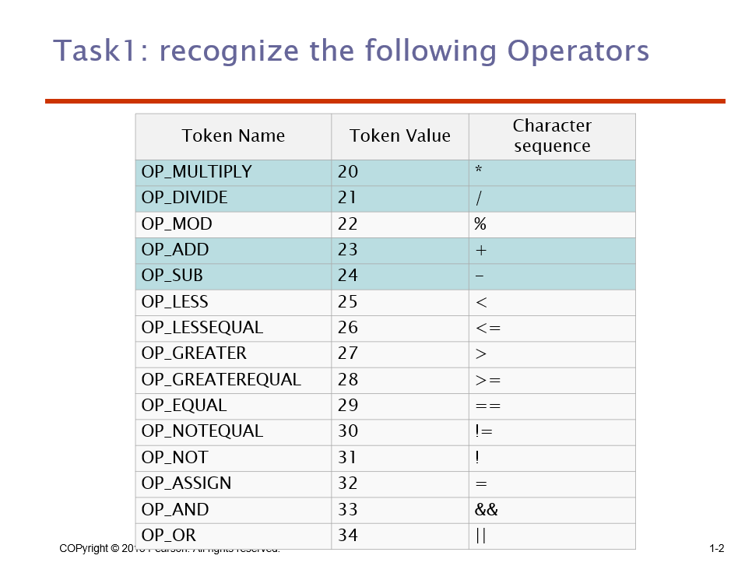
Problem summary: Task 1 design
Notes:
What was the task1

Slide 5
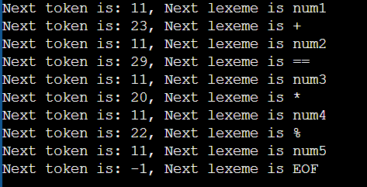
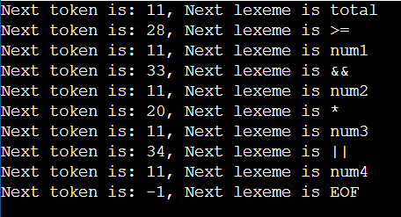
Problem summary: Task 1 design
1. test cases detect all the operators
num1+num2==num3*num4%num5
total>=num1&&num2*num3||num4
result of ①
result of ②
Notes:
task1: design of test cases that detect all the operators & result

Slide 6


Problem summary: Task 1 design
2. test cases including unsupported operators
num1^num2
② var1&var2
Notes:
task1: design of test cases to include unsupported operators & result

Slide 7
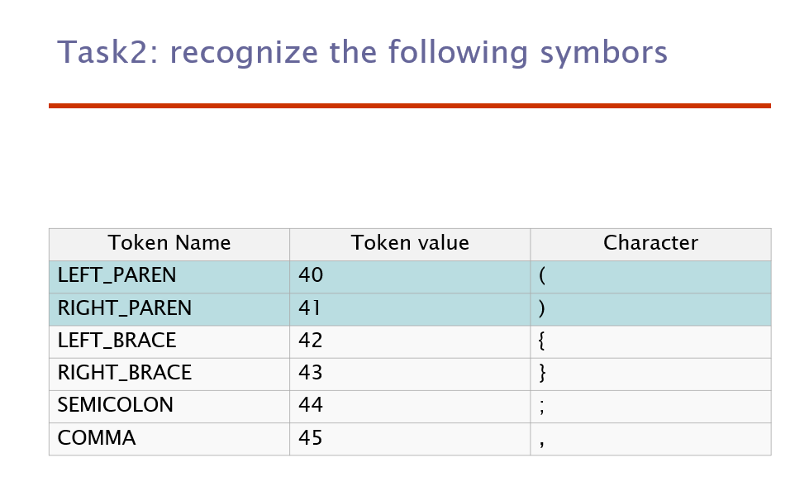
Problem summary: Task 2 design
Notes:
What was the task2

Slide 8
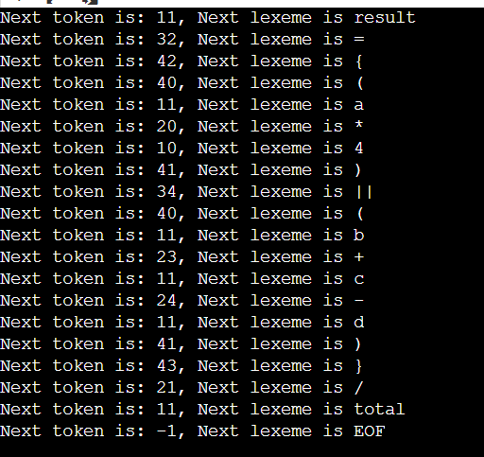
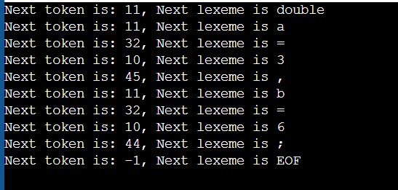
Problem summary: Task 2 design
1. test cases detect all the symbols
result = {(a*4) || (b+c-d)} / total
double a = 3, b = 6;
result of ②
result of ①
Notes:
task2: design of test cases that detect all the symbols & result

Slide 9
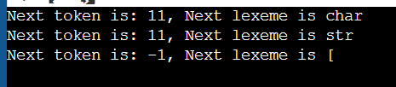
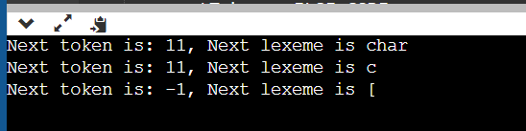
Problem summary: Task 2 design
2. test cases including unsupported operators
char str[10];
② char c[] = "string";
Notes:
task2: design of test cases to include unsupported operators & result

Slide 10
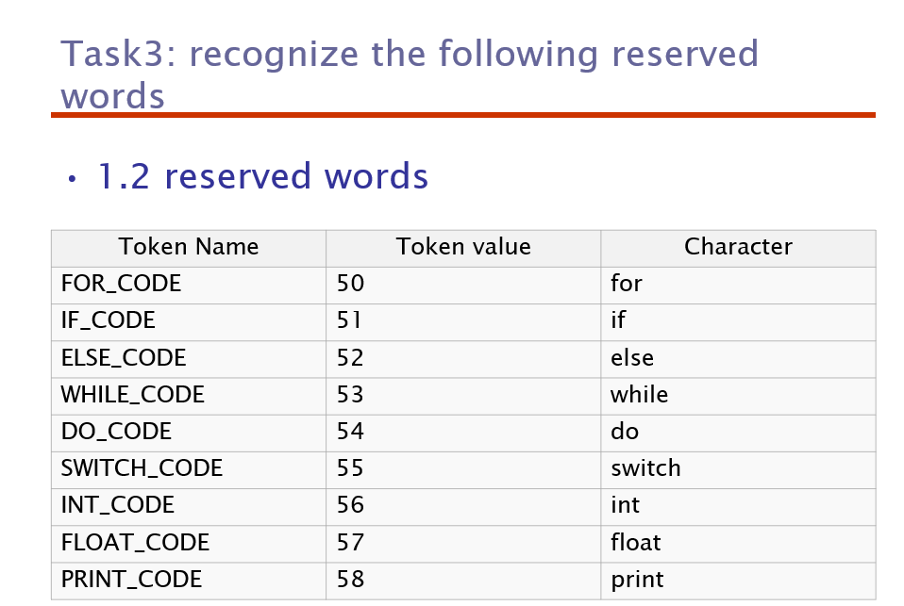
Problem summary: Task 3 design
Notes:
What was the task2

Slide 11
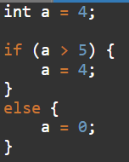
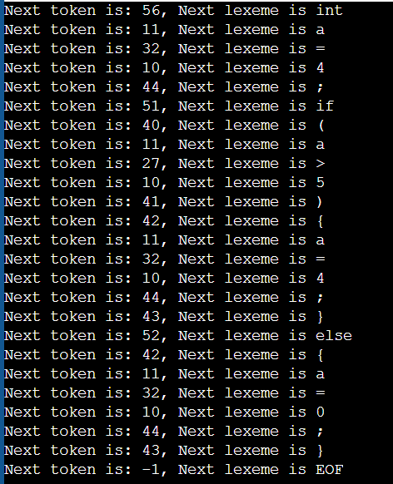
Problem summary: Task 3 design
1. test cases detect all the operators
result of ①
Notes:
task1: design of test cases that detect all the reserved words & result

Slide 12
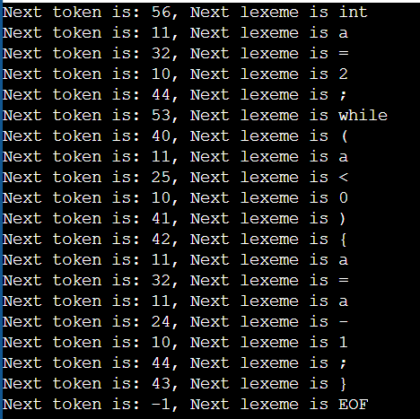
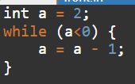
Problem summary: Task 3 design
1. test cases detect all the operators
②
result of ②
Notes:
task1: design of test cases that detect all the reserved words & result

Slide 13




Problem summary: Task 3 design
2. test cases including unsupported operators
②
Notes:
task3: design of test cases to include unsupported reserved words & result

Slide 14
Thank you

